Slide 1
The Relative Date Index
Yoel Kortick
Senior Librarian
Nov. 2025

Slide 2
Agenda
Introduction
Using the new Relative Date Index
Using the new Relative Date Index – Live Example One
Using the new Relative Date Index – Live Example Two
Using the new Relative Date Index – Live Example Three
Future Plans for the Relative Date Index
2

Slide 3
Introduction

Slide 4
Introduction
The Relative Date index was originally developed in the November 2025 release for the titles level searches and is being expanded in 2026.
For a specific case showing one of the many useful aspects of this index see How to create a "New Resources in the Library" list and corresponding link in Primo (using the relative date index and a logical title level collection)

Slide 5

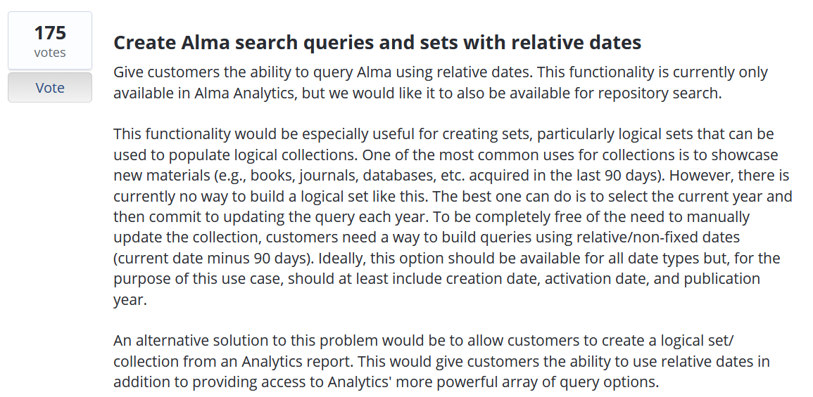
Introduction
The development of the Relative Date Index originated from the Ex Libris Ideas Exchange via the following Idea: Create Alma search queries and sets with relative dates

Slide 6
Introduction
Via the Relative Date index it is possible to search for titles and inventory using a relative date range, such as titles created in the last month.
This is especially useful for users who need to create a logical set based on a time range (such as "within last X days") of records, items, etc., for automated processes such as scheduling a job or creating a logical discovery set, without having to manually update the date range.
This is the use case described in detail at How to create a "New Resources in the Library" list and corresponding link in Primo (using the relative date index and a logical title level collection)

Slide 7
Using the new Relative Date Index

Slide 8
Using the new Relative Date Index
As of the November 2025 release the Relative Date index can be accessed via the various the following Advances Search options.
  All Titles
  Physical Titles
  Electronic Titles
  Digital Titles
  Physical Items

Slide 9
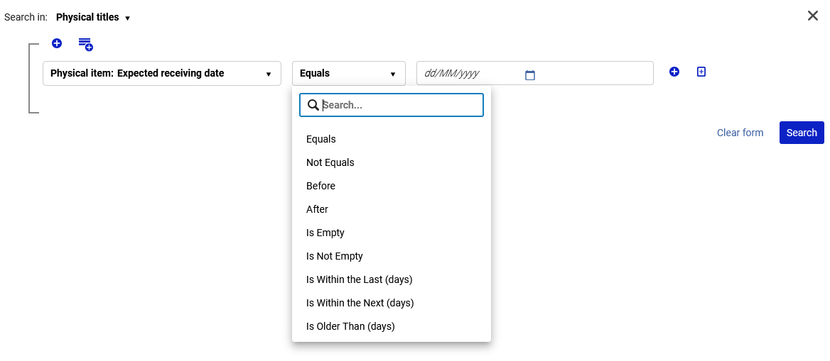
Using the new Relative Date Index
The Relative Date index is used by using one of the following operators:
  Is Within the Last (days)
  Is Within the Next (days)

Slide 10
Using the new Relative Date Index
Example using “Is Within the Last (days)”:
  To retrieve all bibliographic records created in the last week the staff user could search as follows using an “All Titles” search:
  MMS Creation Date (Title) Is Within the Last (days) "7"
Example using “Is Within the Next (days)”:
  To retrieve all bibliographic records which have a physical item which has an expected receiving date in the next two weeks the staff user could search as follows using a “Physical Titles” search:
  Expected receiving date Is Within the Next (days) "14"
Example using “Is Within the Last (days)”:
  To retrieve all physical items with an inventory date in the last week the staff user could search as follows using a “Physical Items” search:
  Inventory date is within the last (days) "7"

Slide 11
Using the new Relative Date Index – Live Example One

Slide 12
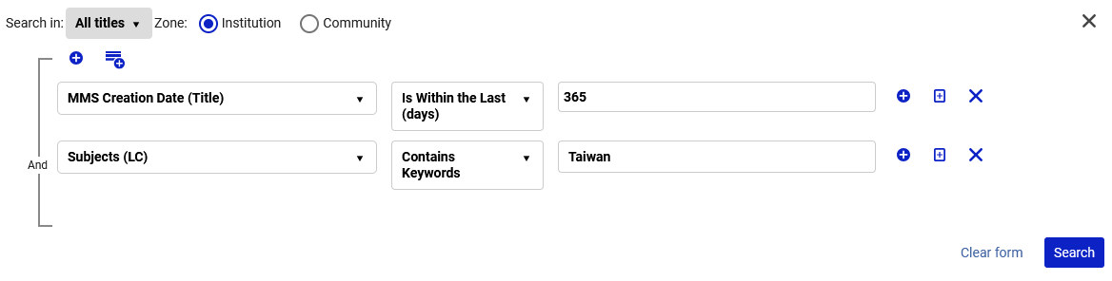
Using the new Relative Date Index – Live Example One
Here for example, we are retrieving all titles which were created in the last 365 days and have a word from the Subject (LC) “Taiwan” (Today is Nov. 06, 2025).

Slide 13
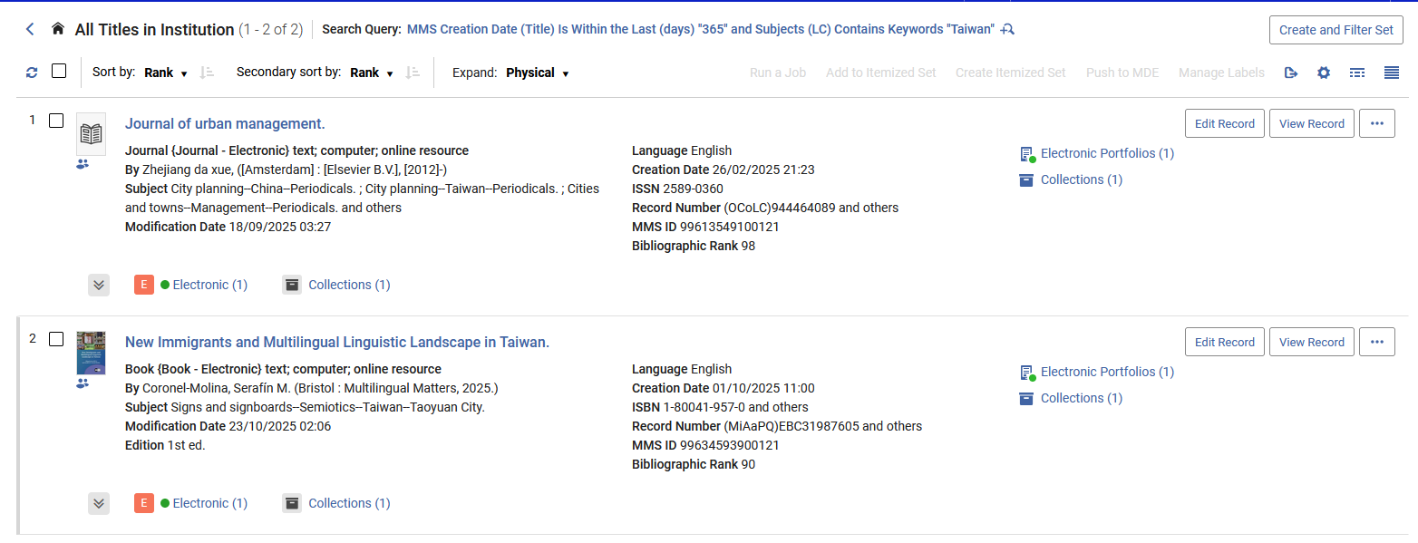
Using the new Relative Date Index – Live Example One
All results were created in the last 365 days and have a word from the Subject (LC) “Taiwan”
Today is Nov. 06, 2025. Therefore, both of these creation dates are within the last 365 days

Slide 14
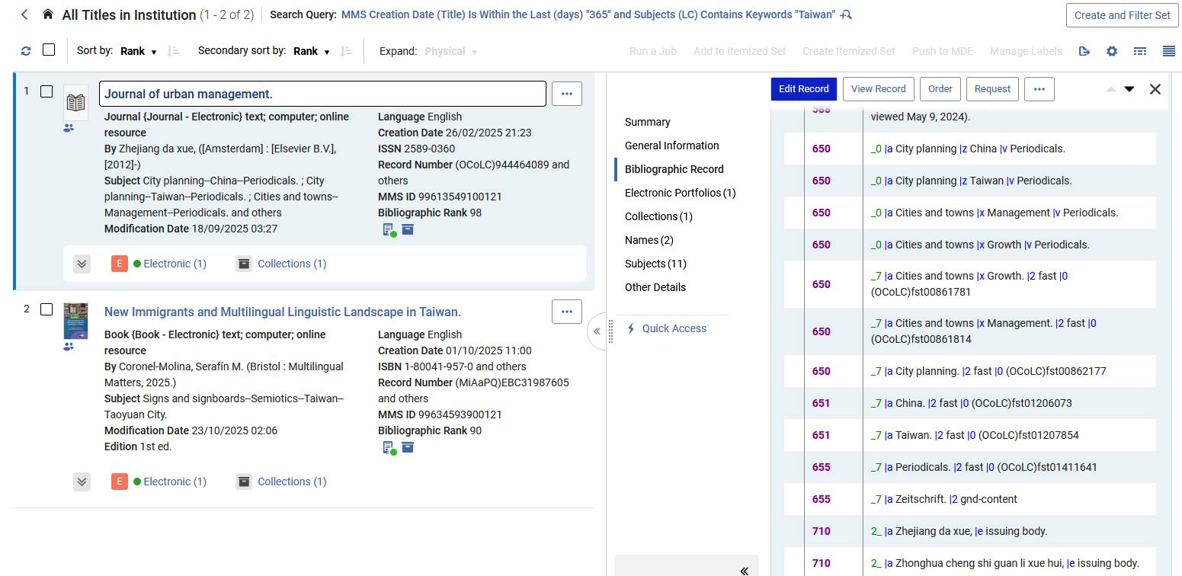
Using the new Relative Date Index – Live Example One
All results were created in the last 365 days and have a word from the Subject (LC) “Taiwan”

Slide 15
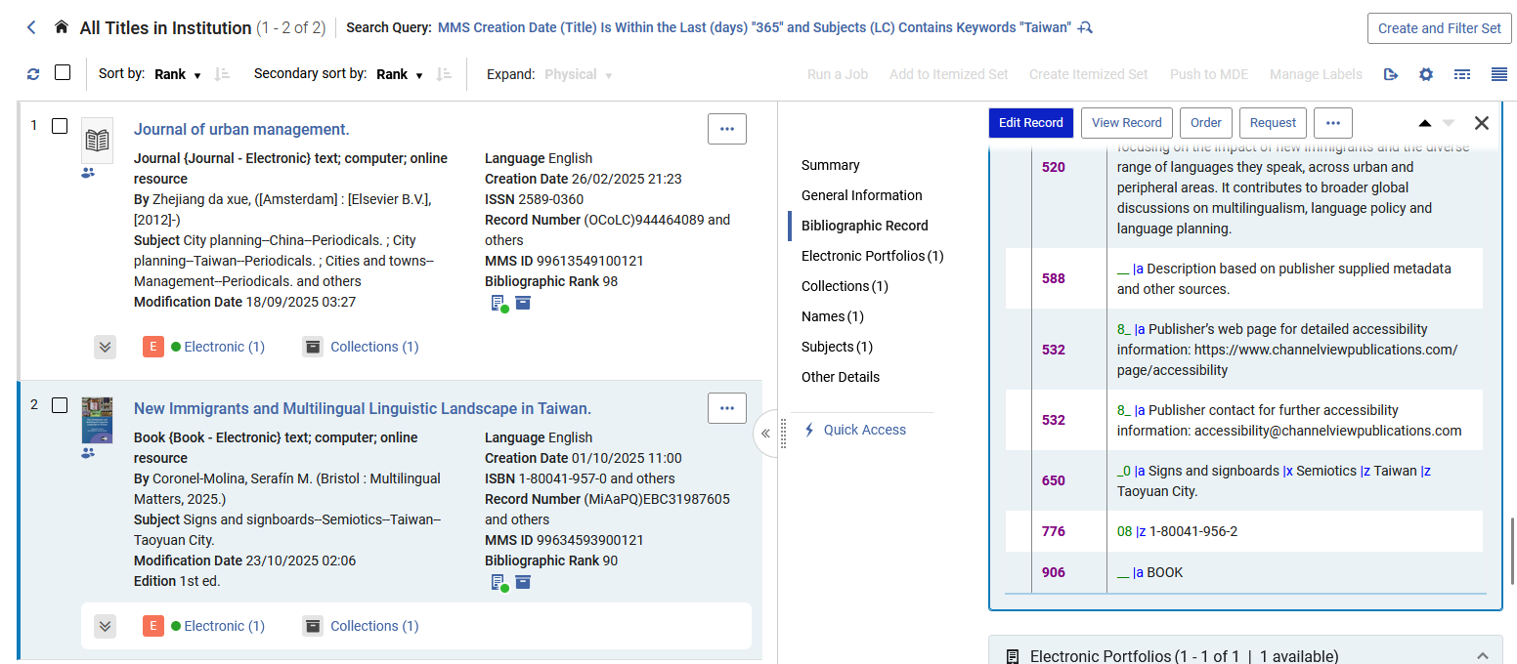
Using the new Relative Date Index – Live Example One
All results were created in the last 365 days and have a word from the Subject (LC) “Taiwan”

Slide 16
Using the new Relative Date Index – Live Example Two

Slide 17
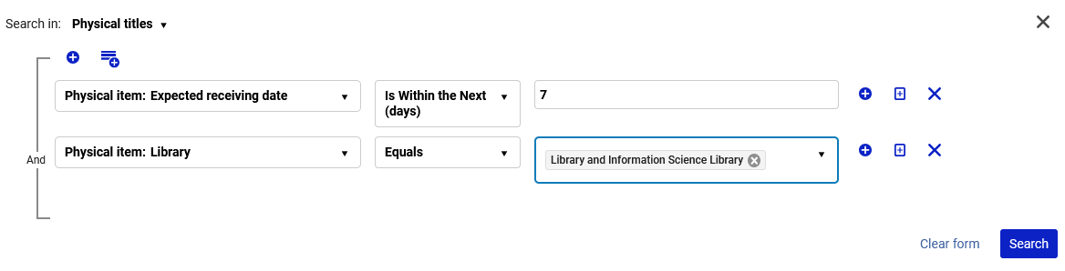
Using the new Relative Date Index – Live Example Two
Here for example, we are retrieving all physical titles which have an item which has an expected receiving date in the next 7 days and is in the “Library and Information Science Library” (Today is Nov. 06, 2025).

Slide 18
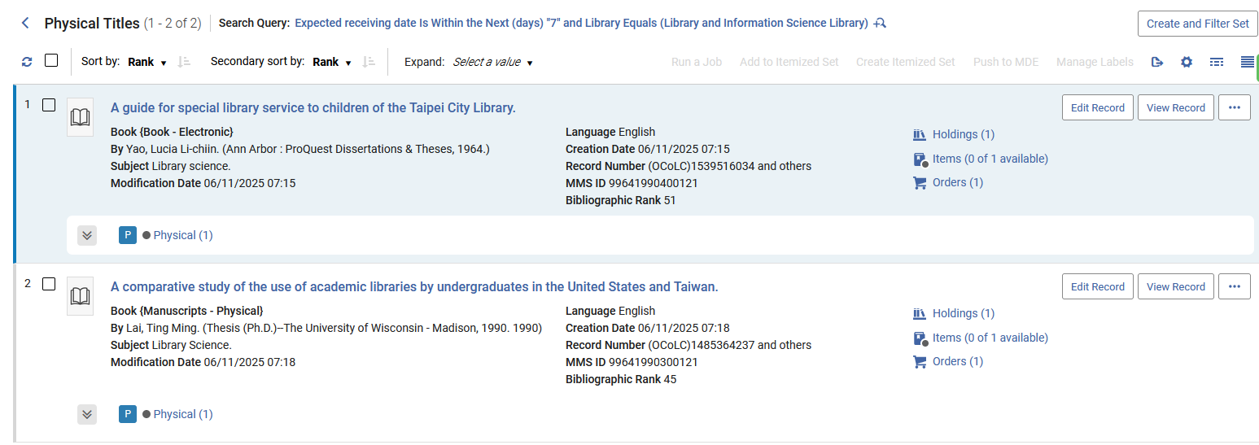
Using the new Relative Date Index – Live Example Two
We have two results

Slide 19
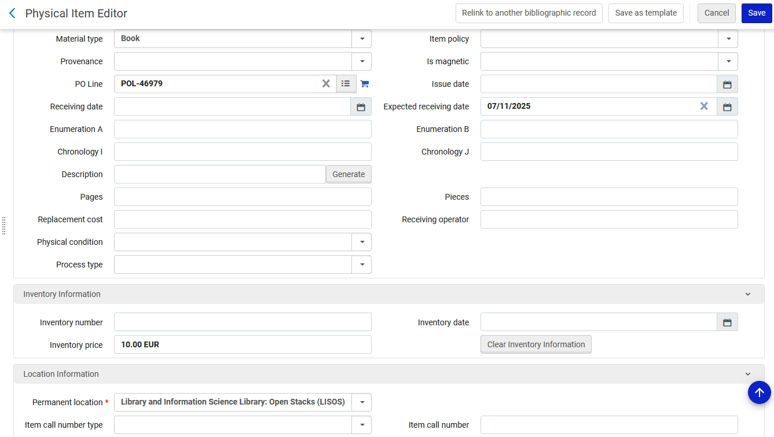
Using the new Relative Date Index – Live Example Two
The first record has an item with an expected receiving date in the next 7 days, and the item is in the Library and Information Science Library (It is part of POL-46979)
Today is Nov. 06, 2025. Therefore, this date is within the next 7 days

Slide 20
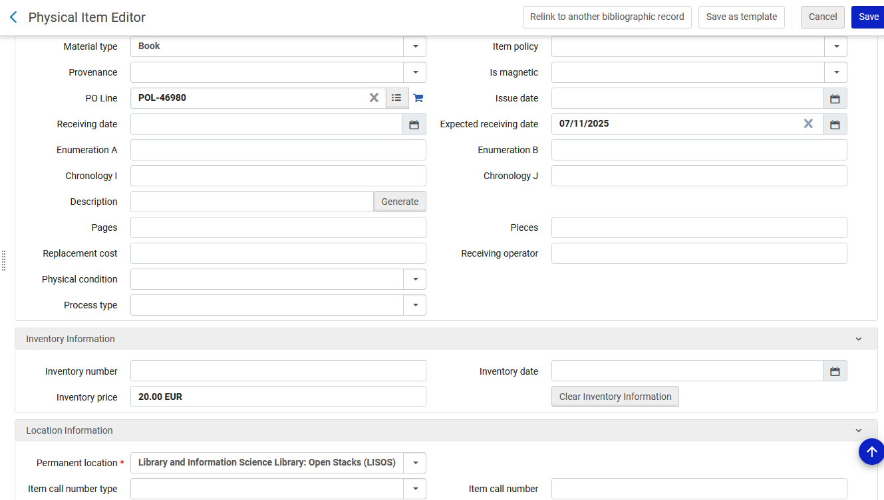
Using the new Relative Date Index – Live Example Two
The second record has an item with an expected receiving date in the next 7 days, and the item is in the Library and Information Science Library (It is part of POL-46980)
Today is Nov. 06, 2025. Therefore, this date is within the next 7 days

Slide 21
Using the new Relative Date Index – Live Example Three

Slide 22
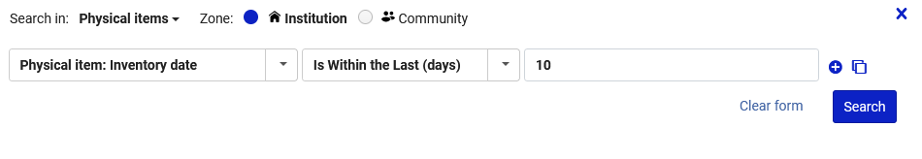
Using the new Relative Date Index – Live Example Three
Here for example, we are retrieving all physical items which have an inventory date in the last 10 days (Today is Nov. 06, 2025).

Slide 23
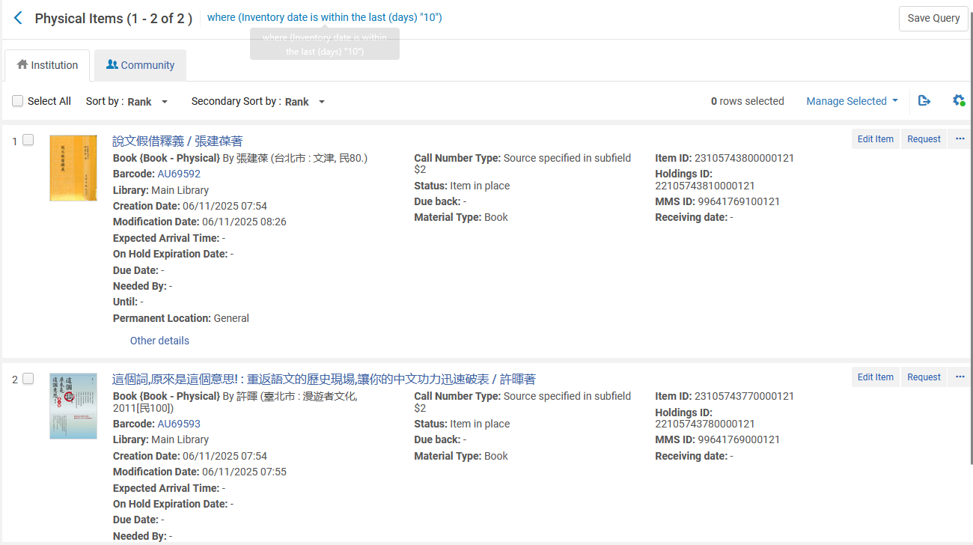
Using the new Relative Date Index – Live Example Three
We have two results

Slide 24
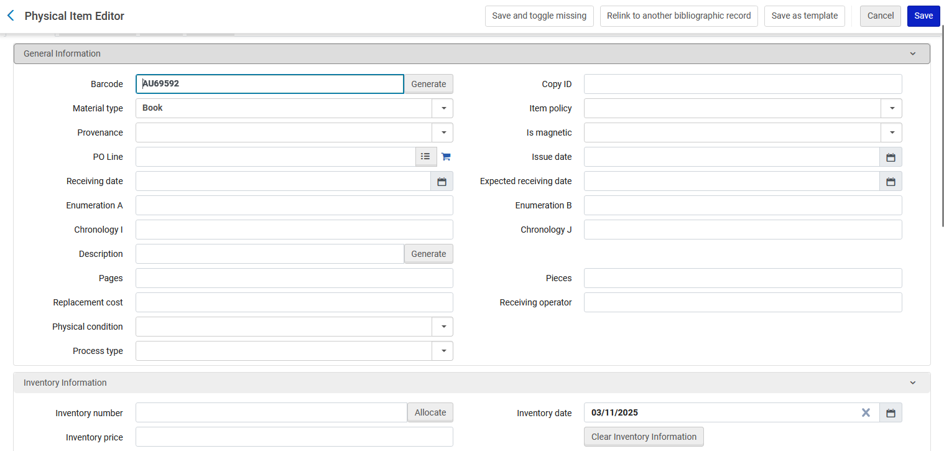
Using the new Relative Date Index – Live Example Three
The first record has an item with an inventory date in the last 10 days
Today is Nov. 06, 2025. Therefore, this date is within the last 10 days

Slide 25
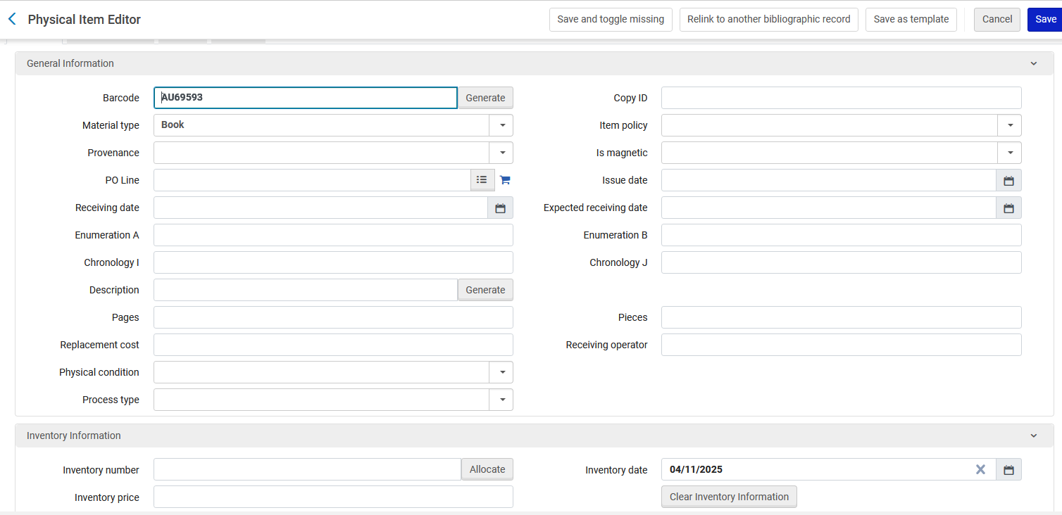
Using the new Relative Date Index – Live Example Three
The second record has an item with an inventory date in the last 10 days
Today is Nov. 06, 2025. Therefore, this date is within the last 10 days

Slide 26
Future Plans for the Relative Date Index

Slide 27
Future Plans for the Relative Date Index
Tentatively planned for the Feb. 2026 release: support the “Is Within the Last (Days)” and “Is Within the Next (Days)” for the PO Lines search.
This will allow, for example, to be able to search by the following fields using the Relative Date index :
  PO Line Creation Date
  PO Line Sent Date
  PO Line Renewal Date
URM-241620

